Slide 1
PHOTOSYNTHESIS: LIGHT REACTION
GOPAL KRISHNA GOKHALE COLLEGE, KOLHAPUR
Dr. R. P. Jadhav M.Sc., M.Phil., Ph.D.
Dead Dept. of Botany.
ravindrajadhav7550@gmail.com
Department of Botany

Slide 2
Photosynthesis

Slide 3
Photosynthesis.
CO₂ from atmosphere, H₂O from soil
Requires correct enzymes and pigments plus sunlight (red and blue,) ATP, NADPH to convert the reactants into the products
6CO₂ + 12H₂O → C₆H₁₂O₆ + 6O₂ + 6H₂O
Notes:
Photosynthesis will be described as it occurs in most eukaryotic cells.

Slide 4
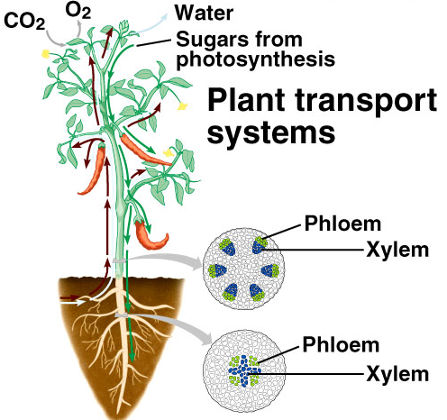

Slide 5
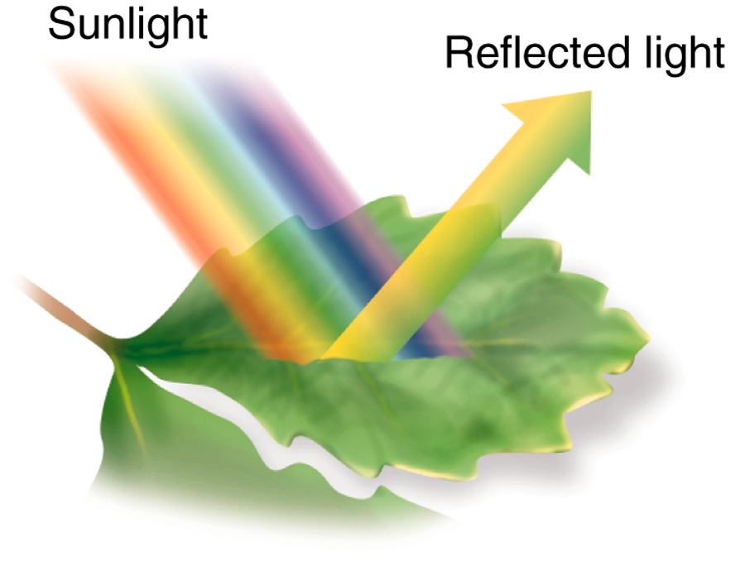
What happens to light when it strikes an object?
reflected (bounces off)
transmitted (passes through)
absorbed
Only absorbed wavelengths of light function in photosynthesis.
Notes:
Reflected or transmitted wavelengths determine the color of the object. Leaves appear to be green because the pigments they possess reflect green wavelengths of light.
Objects that reflect all wavelengths of light (absorb none) are white, while objects that reflect none (absorb all) are black.

Slide 6
Water
Carbon dioxide
Raw materials
ADP
Light Dependent Phase
Process: Energy Capture via Photosystems I and II
Location: Thylakoid
Light Independent Phase
Process: Carbon fixation via the Calvin cycle
Location: Stroma
ATP
Main product
Glucose
Solar
energy
NADP.H2
NADP
Oxygen
Water
By-products

Slide 7
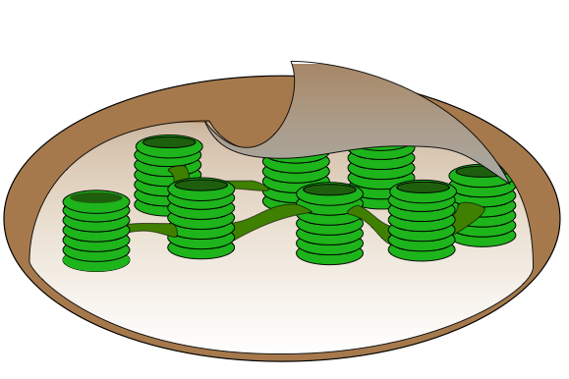
A Summary of Photosynthesis…
Water from the cell sap is used as a raw material
Sunlight
ATP
NADPH + H⁺
Oxygen gas (from the break up of water molecules) is given off as a waste product.
Water is given off as a waste product.
Hydrogen (from the break up of water molecules) is used as a raw material.
Carbon dioxide from the air provides carbon and oxygen as raw materials. Carbon is fixed in the Light independent phase
triose phosphate
(a 3-carbon sugar)

Slide 8
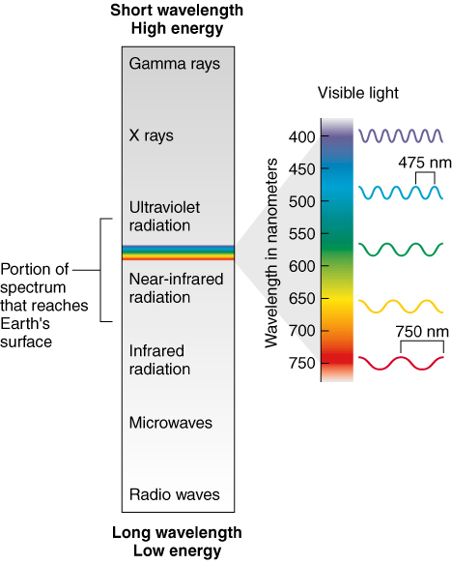
Light
Visible light makes up only a small portion of the electromagnetic spectrum.
Notes:
Of these 3 types of radiation, we are primarily concerned with visible light because it provides the right amount of energy to power photosynthesis. [UV radiation is too powerful, while infrared radiation is not powerful enough]

Slide 9
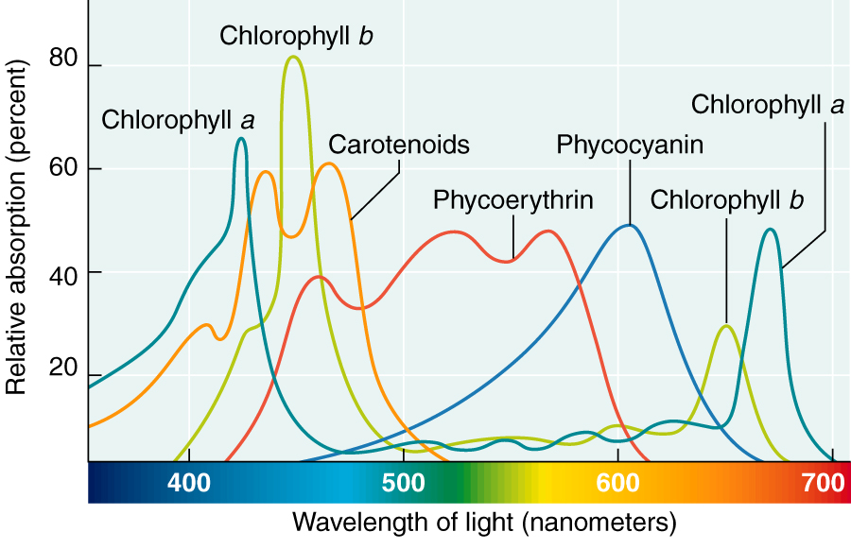

Slide 10
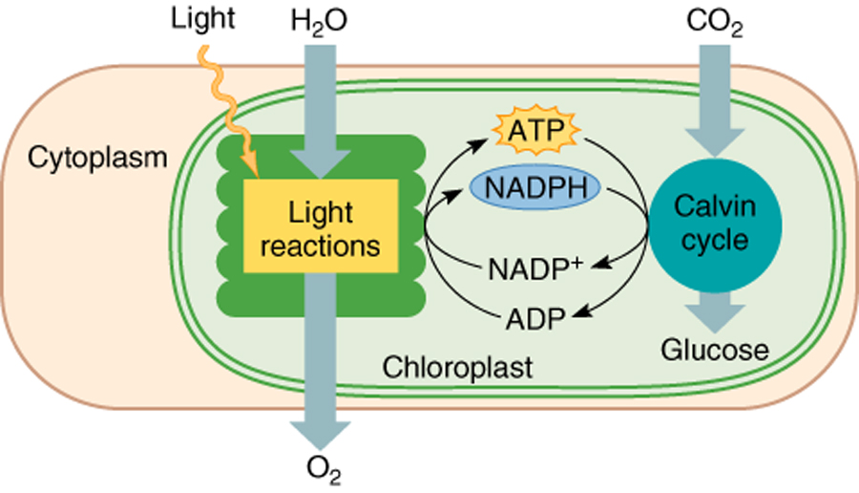
Overview of Photosynthesis

Slide 11
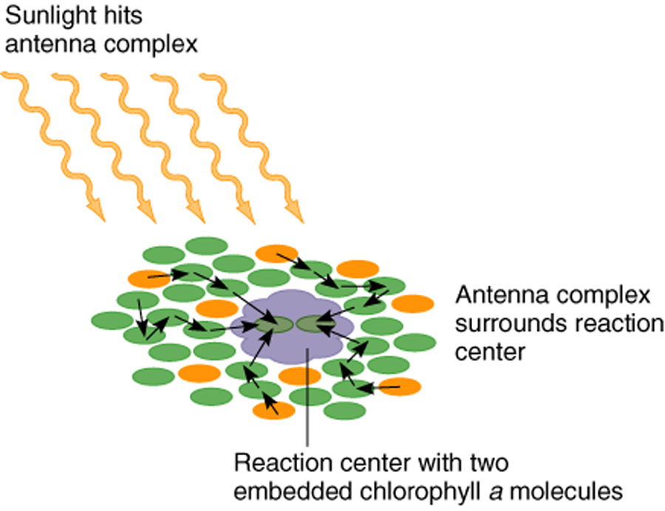
Light Reactions
require light
occur in thylakoids of chloroplasts
involve photosystems II & I (light harvesting systems).
Photosystems contain antenna complex that captures photon energy & passes it to a reaction center.
Notes:
Antenna complex contains about 300 chlorophyll molecules & 50 accessory pigments.
Reaction center contains a pair of reactive chlorophyll a molecules.
Reaction center of photosystem I contains a pair of P700 chlorophyll a molecules (P stands for pigment; they absorb light energy mostly at 700nm).
Reaction center of photosystem II contains a pair of P680 chlorophyll a molecules (they absorb light energy mostly at 680nm).

Slide 12
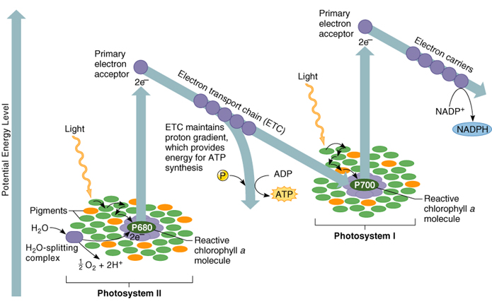
Light Reactions of Photosynthesis
Notes:
Both photosystems and electron transport chains are embedded in thylokoid membranes.
Light reactions begin with photosystem II.
1. Light strikes PSII, exciting 2 electrons, which are passed to an electron acceptor. [Electrons lost from PSII must be replaced - replacement electrons are obtained by splitting water (O₂ is released as a byproduct of the light reactions)].
2. Electrons (from PSII) flow down ETC, providing energy for production of ATP by chemiosmotic phosphorylation.
3. Light strikes PSI, exciting 2 electrons, which are passed to an acceptor molecule. Electrons reaching bottom of ETC are passed to PSI as replacement electrons.
4. Excited electrons flow down a 2nd ETC, providing energy for production of NADPH.
Note: electrons released when water was split eventually end up in NADPH!!!!

Slide 13
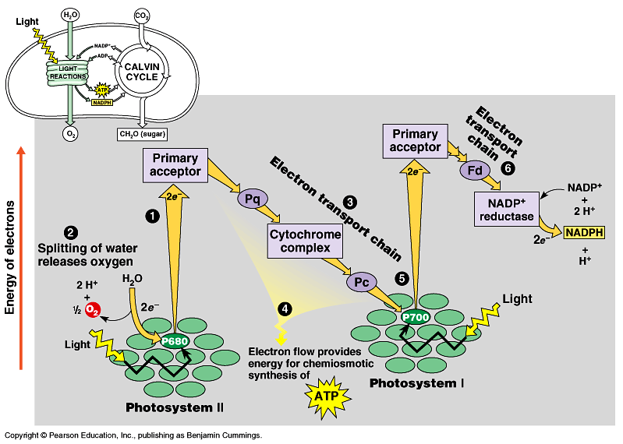
Light Reactions
Light drives both photosystems (PS).
Water splits, O₂ formed & electron to PS II
excited electron enters ETC. ATP is made, similar to respiration.
electron replaces the one lost in PS I.
electron from PS I enters ETC.
6. This ETC produces NADPH
Fig. 10.13
Copyright © 2002 Pearson Education, Inc., publishing as Benjamin Cummings

Slide 14
Light Dependent Reactions – the Z-Scheme

Slide 15
Light Dependent Reactions
Products:
ATP
NADPH
O₂

Slide 16
Thank You

